Slide 1
2016 Nonroad Collaborative Work Group
28 March 2019
Local Conference Lines:
Main line: 202-991-0477
EPA Region 1 (Boston): 857-702-8290 EPA Region 2 (NYC): 347-384-7287
EPA Region 3 (Philadelphia): 484-352-3221 EPA Region 4 (Atlanta): 470-705-2279
EPA Region 5 (Chicago): 312-667-7115 EPA Region 6 (Dallas): 469-250-2701
EPA Region 7 (Kansas City): 913-608-8349 EPA Region 8 (Denver): 720-642-6536
EPA Region 9 (San Francisco): 628-246-1294 EPA Region 10 (Seattle): 206-800-4483
EPA RTP (Raleigh): 984-444-7480
Conference ID: 6926578

Slide 2
Meeting Agenda
Beta inventory release
Beta emissions by sector
2016 v1 inventory
Nonroad updates for v1
Testing geographic allocation updates
v1 timeline
Other business/reminders

Slide 3
Beta inventory release
2016 beta emissions modeling platform released on March 13
2016 beta release includes: 2016 inventories for all anthropogenic sectors, 2016 inventories for fires, 2016 MEGAN and BEIS3 biogenic emission on the 12US2 CONUS domain, and documentation
Data being distributed by the Intermountain West Data Warehouse (IWDW)
2016 beta wiki: http://views.cira.colostate.edu/wiki/wiki/10197. Contains links to documentation and analysis products from LADCO, IWDW.
Projections to 2023 and 2028 will be released to Collaborative members in April
Summary files available on the Collaborative Google Drive: https://drive.google.com/drive/u/0/folders/1yFEmYlWgcjKkeS48UQ0SerYZdpTY0oEm

Slide 4
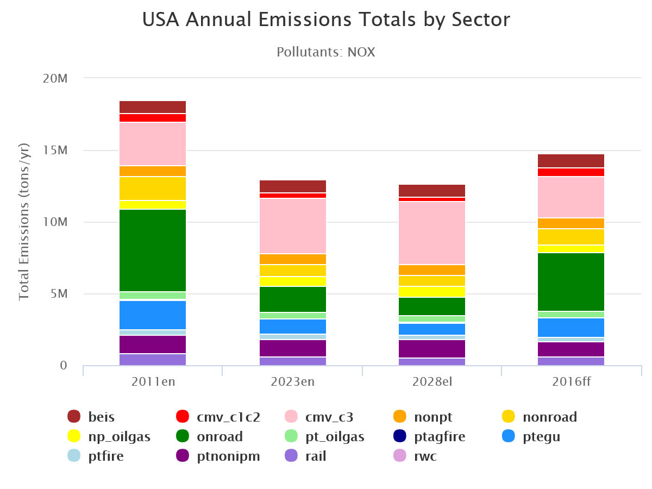
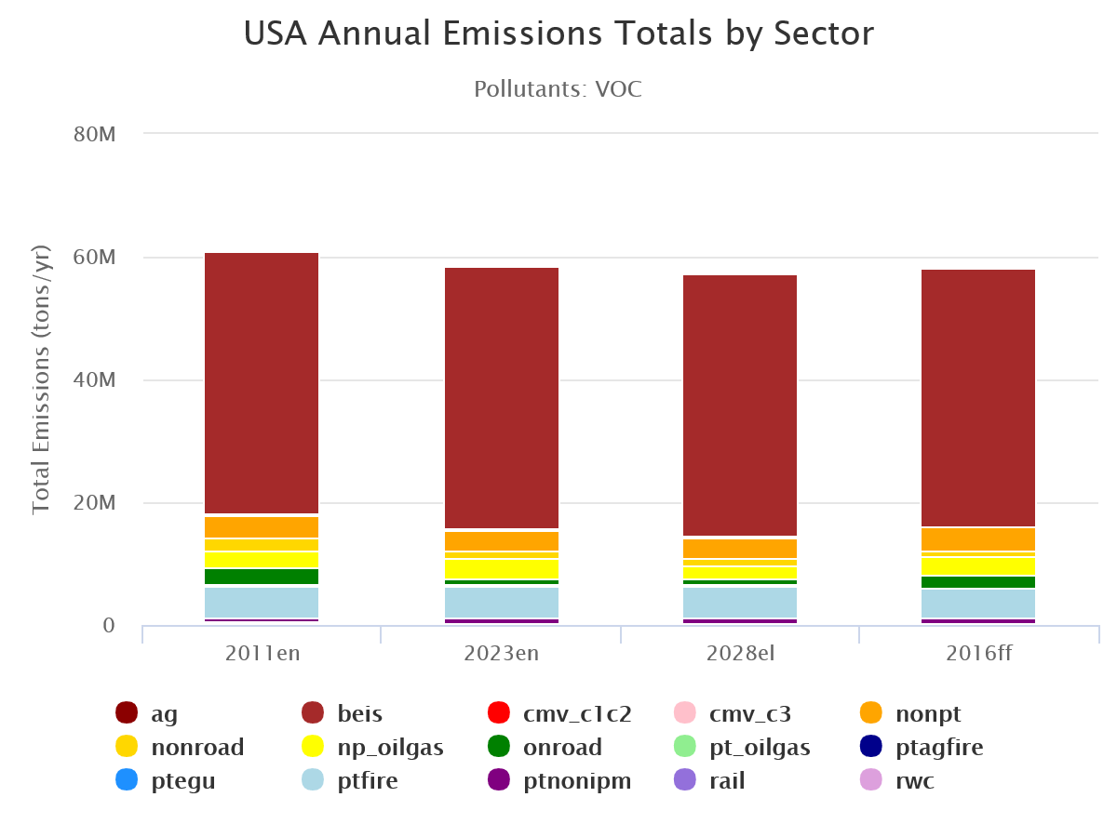
Beta Emissions by Sector
Onroad | 4,065,540 (44.2%)
Nonroad | 1,102,956 (12.0%)
C3 CMV | 2,915,608 (31.7%)
C1/C2 CMV | 564,394 (6.1%)
Rail | 557,598 (6.1%)
Onroad | 1,198,763 (60.0%)
Nonroad | 1,175,789 (35.6%)
C3 CMV | 109,637 (3.3%)
C1/C2 CMV | 10,080 (0.3%)
Rail | 26,008 (0.8%)
2016 Beta
Mobile NOx
Inventory (tons)
2016 Beta
Mobile VOC
Inventory (tons)

Slide 5
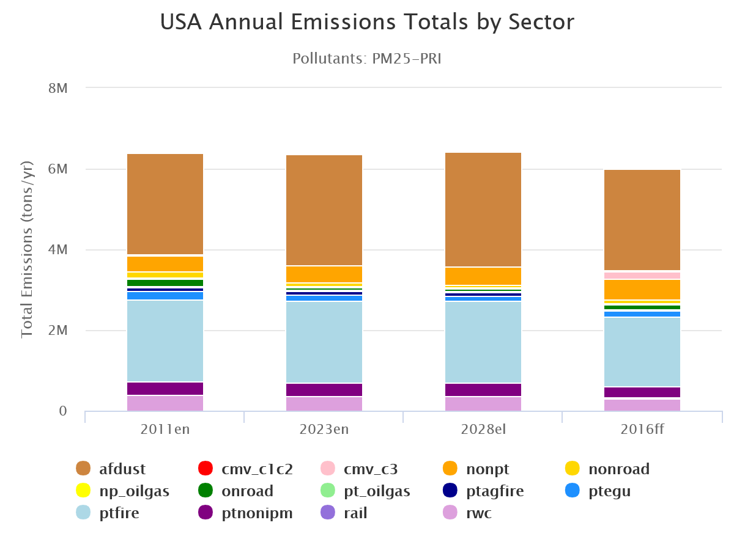
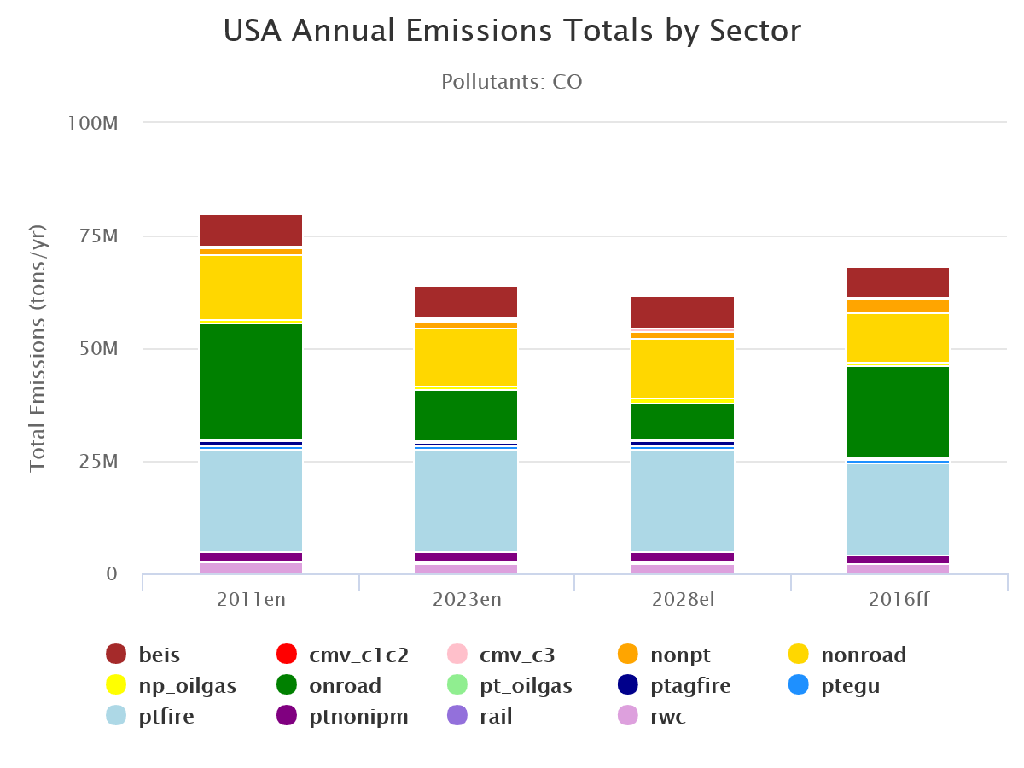
Beta Emissions by Sector
Onroad | 130,564 (28.6%)
Nonroad | 104,500 (22.9%)
C3 CMV | 189,799 (41.6%)
C1/C2 CMV | 14,864 (3.3%)
Rail | 16,125 (3.5%)
Onroad | 20,330,093 (63.7%)
Nonroad | 11,089,466 (34.8%)
C3 CMV | 254,421 (0.8%)
C1/C2 CMV | 114,785 (0.4%)
Rail | 102,929 (0.3%)
2016 Beta
Mobile PM2.5
Inventory (tons)
2016 Beta
Mobile CO
Inventory (tons)

Slide 6
Nonroad v1 inventory
Will include data supplied by States for 2016 platform and 2017 NEI (EPA currently reviewing)
National updates: geographic allocation factors for Agricultural and Construction equipment
North Carolina DEQ and EPA updated the nrstatesurrogate table with updated state-to-county allocation factors
Construction: acres disturbed by residential, non-residential, and road construction (2014 NEI)
Agricultural: fuel expenditure data from USDA
Base year state-level Agriculture and Construction equipment populations were adjusted by modifying the nrbaseyearpopulation table
Scaled each state’s share of the national equipment population total by the state’s share of national acres disturbed by construction activity (Construction equipment) and national fuel expenditure data (Agricultural equipment)
OTAQ tested new tables with a simple runspec: all U.S. counties, single July weekday in 2016, NOx, Agriculture and Construction sectors
Results compare current MOVES2014b allocations to new allocations (new county allocations only and new state+county allocations)
Testing output and updated nrstatesurrogate table posted on Nonroad wiki

Slide 7
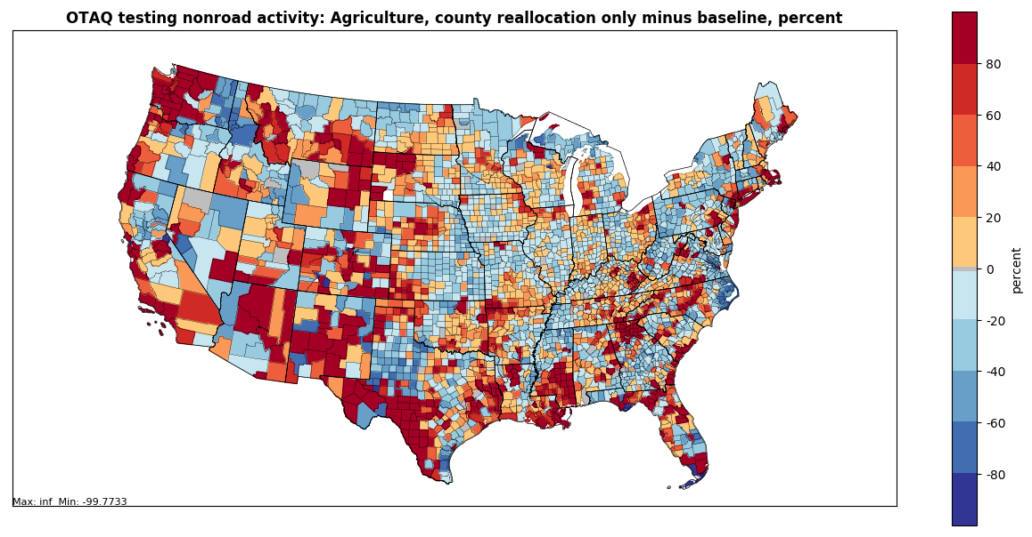
Nonroad v1 inventory – allocation updates
Number of counties that go from zero Ag. emissions to non-zero Ag. emissions: 5
Number of counties that go from non-zero Ag. emissions to zero Ag. emissions: 0
Number of counties with emissions increases relative to MOVES2014b: 1599
Number of counties with emissions decreases relative to MOVES2014b: 1557
National-scale (including PR and VI) Agricultural sector emissions decrease 0.012%

Slide 8
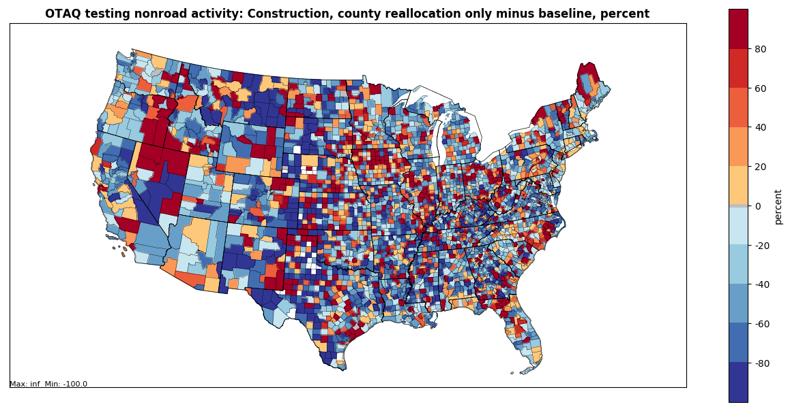
Nonroad v1 inventory – allocation updates
Number of counties that go from zero Const. emissions to non-zero Const. emissions: 44
Number of counties that go from non-zero Const. emissions to zero Const. emissions: 185
Number of counties with emissions increases relative to MOVES2014b: 1227
Number of counties with emissions decreases relative to MOVES2014b: 1973
National-scale (including PR and VI) Construction sector emissions decrease 0.342%

Slide 9
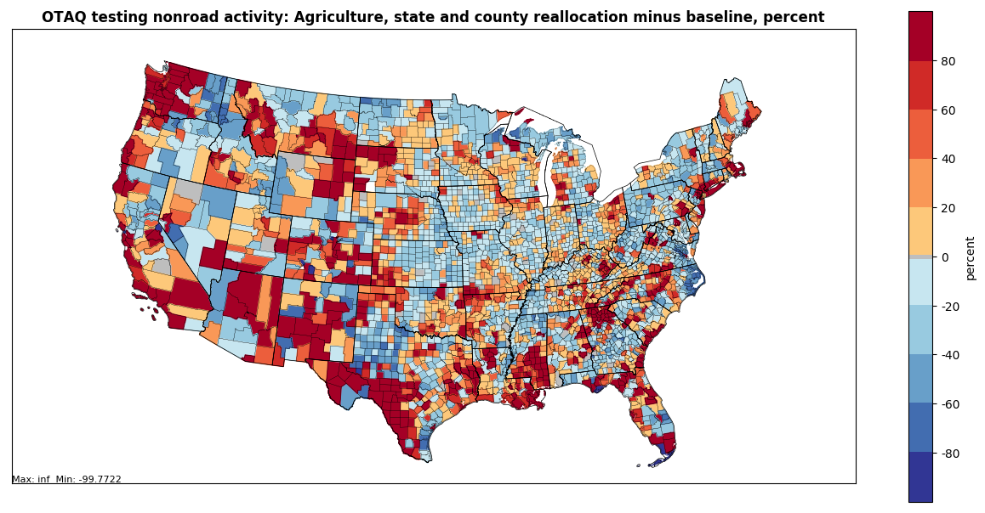
Nonroad v1 inventory – allocation updates
Number of counties that go from zero Ag. emissions to non-zero Ag. emissions: 5
Number of counties that go from non-zero Ag. emissions to zero Ag. emissions: 0
Number of counties with emissions increases relative to MOVES2014b: 1588
Number of counties with emissions decreases relative to MOVES2014b: 1568
National-scale (including PR and VI) Agricultural sector emissions decrease 1.04%

Slide 10
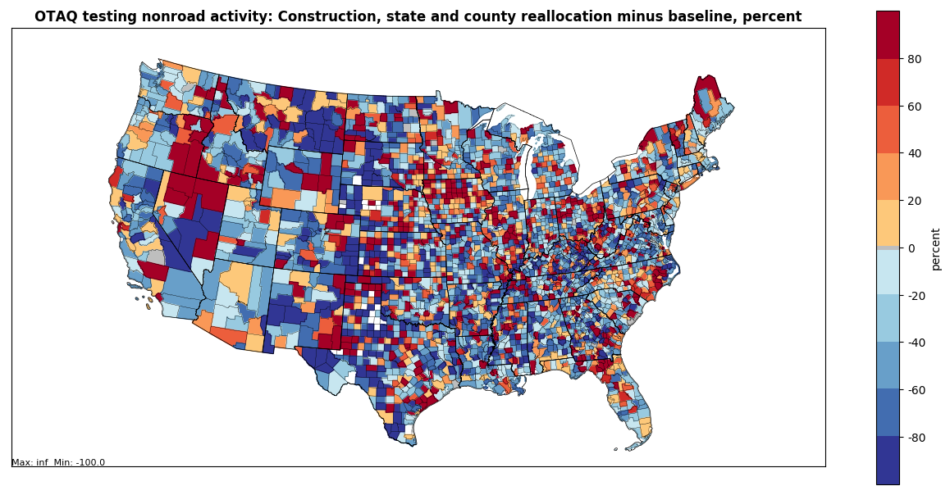
Nonroad v1 inventory – allocation updates
Number of counties that go from zero Const. emissions to non-zero Const. emissions: 44
Number of counties that go from non-zero Const. emissions to zero Const. emissions: 185
Number of counties with emissions increases relative to MOVES2014b: 1227
Number of counties with emissions decreases relative to MOVES2014b: 1973
National-scale (including PR and VI) Construction sector emissions decrease 0.72%

Slide 11
v1 inventory timeline/next steps
Contractual delays have impeded EPA progress in reviewing and incorporating state-supplied data into v1 CDBs
Targeting spring completion for 2016 v1
Will complete 2016 v1 before 2017 NEI onroad/nonroad
Collaborative is collecting comments on the beta platform though May 31, 2019. Using CMAS forum to collect comments: https://forum.cmascenter.org/c/nei-modeling-platform/collaborative-modeling-platform-2016

Slide 12
Other Business / Reminders
Questions and Discussion
Reminders:
Comments on beta platform by May 31: https://forum.cmascenter.org/c/nei-modeling-platform/collaborative-modeling-platform-2016
2016 beta summary files on Google Drive: https://drive.google.com/drive/u/0/folders/1yFEmYlWgcjKkeS48UQ0SerYZdpTY0oEm
Next national report-out quarterly update call (all sectors) is April 3 at 12:00 EDT. Registration: https://register.gotowebinar.com/register/8872782148303361026
Work Group meeting minutes and related files and links available on Work Group wiki: http://views.cira.colostate.edu/wiki/wiki/9179
Next meeting: TBD

